Slide 1


Data Structures
Lab # 1

Slide 2
Self Check
01
04
Variables
Index
02
05
Loops
Basic Math
03
if else

Slide 3

Data Structure
A data structure is a systematic way of organizing and accessing data.
Reference: Michael T. Goodrich, Roberto Tamassia, and Michael H. Goldwasser, Data Structures and Algorithms in Java, 6th ed., Wiley, 2014

Slide 4
Why?
We study data structures to choose the right way to organize data so our programs are fast, memory-efficient, and easy to maintain, especially as the data grows.
Reference: Michael T. Goodrich, Roberto Tamassia, and Michael H. Goldwasser, Data Structures and Algorithms in Java, 6th ed., Wiley, 2014

Slide 5
Structured Data
Organized
Fixed Structure
Tables, Arrays

Slide 6
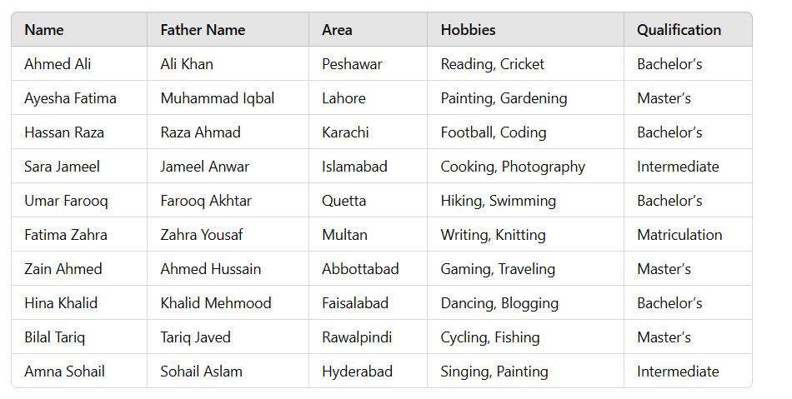
Understanding Structured Data?

Slide 7
Unstructured Data
Free Form Text
No Predefined Format
Image , Videos , Audio

Slide 8
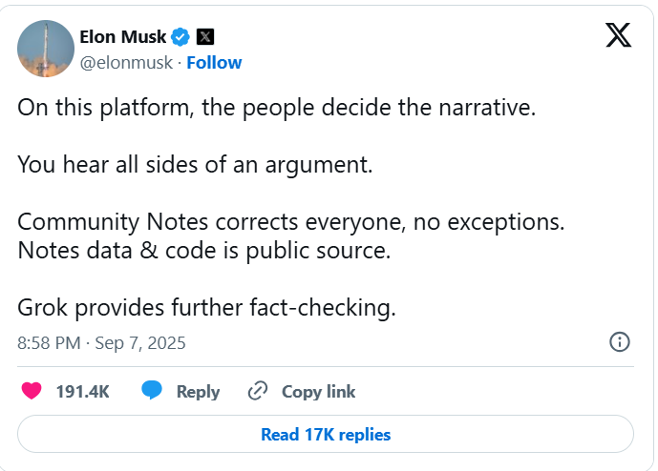
Understanding Structured Data?

Slide 9
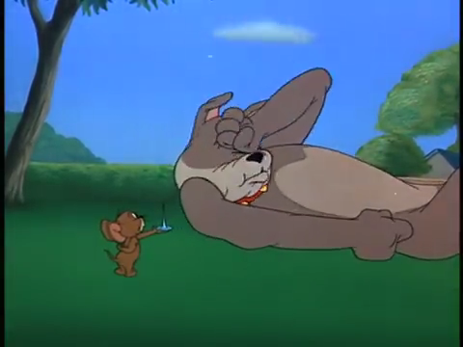
Understanding Structured Data?

Slide 10
Understanding Structured Data?
Tom and Jerry - Fit to be tied
Jerry help the dog
Tom bind the dog with rope
An episode in which dog hits tom in tom and jerry
Tom was beaten by dog and jerry

Slide 11

THANK YOU!

